Slide 1
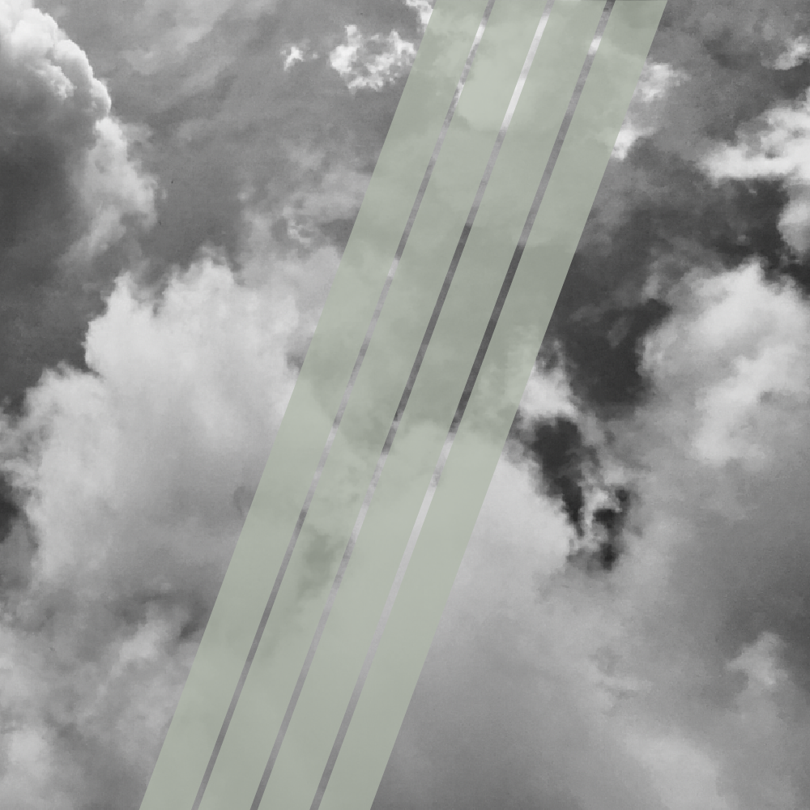
it’s how the Church
has been gathering
since the beginning

Slide 2
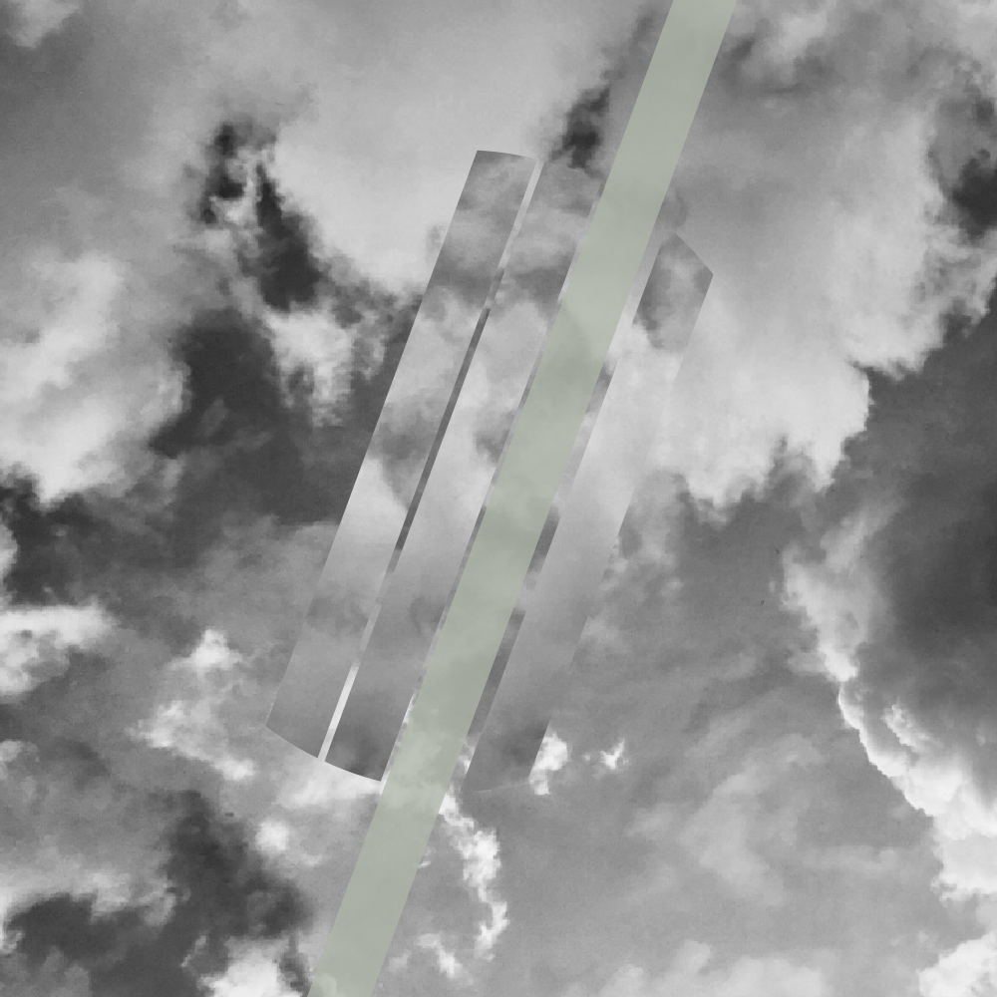
season 1
begins august 5
liturgical
scriptural
relevant

Slide 3
season 1
begins august 5

